Slide 1


Dataflow: a web-based solution to data reduction
Andrew Tracer - SURF

Slide 2
Collaborators
William Ratcliff, Brian Maranville,
Paul Kienzle, Andrew Jackson
Alex Yee, Brendan Rowan,
Elakian Kanakaraj, Ophir Lifshitz

Slide 3
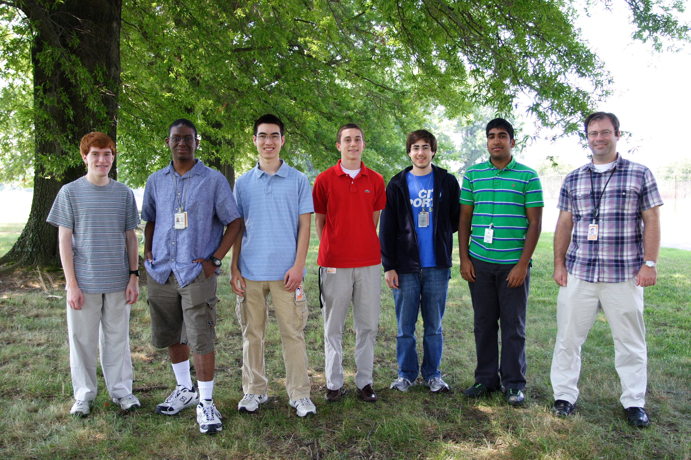
Collaborators

Slide 4
Contributions
Alex: triple-axis
Brendan: offspecular and caching
Elakian: small-angle
Ophir: plotting and interactors
Andrew: development environment, database, server config, editor

Slide 5
Existing reduction software
Painful to install
Updating requires time and effort for user
Cannot archive reduction procedure

Slide 6
Dataflow
Graphical,
  web-based,
      data reduction
      application.
Notes:
No installation required
Updating takes place instantaneously
Intuitive, graphical interface
Manage your projects and experiments
Archive how you reduced your data!
.

Slide 7
Dataflow
Graphical,
  web-based,
      data reduction
      application.
Notes:
Web-based solves problems 1-2.
Our output files solve 3.

Slide 8
Dataflow
Graphical,
  web-based,
      data reduction
      application.
Notes:
Web-based solves problems 1-2.
Our output files solve 3.

Slide 9
Dataflow
Graphical,
  web-based,
      data reduction
      application.
Notes:
Web-based solves problems 1-2.
Our output files solve 3.

Slide 10
Dataflow
Graphical,
  web-based,
      data reduction
      application.
Notes:
No installation required
Updating takes place instantaneously
Intuitive, graphical interface
Manage your projects and experiments
Archive how you reduced your data!
.

Slide 12
Small-Angle Neutron Scattering (SANS) Reduction
Elakian Kanakaraj - SHIP

Slide 13
Corrections
-Initial Correction: COR = (SAM - BGD) - [Tsam/Temp](EMP – BGD)
-Detector Sensitivity: CAL = COR/DIV
-Absolute Scaling: ABS = (Scalar)*CAL
-Circular Average: Convert to 1D, Q vs. I plot

Slide 14
Future Plans - SANS
Widgets
MASK
Patching
Saving

Slide 16
Data Reduction for
Triple-Axis Spectrometry
Alex Yee - SHIP

Slide 17

Web-based Data Reduction
Easy to access
Version unity
Platform independence
Browser independence
Potential for cluster computing
Potential for immediate data input and use

Slide 18
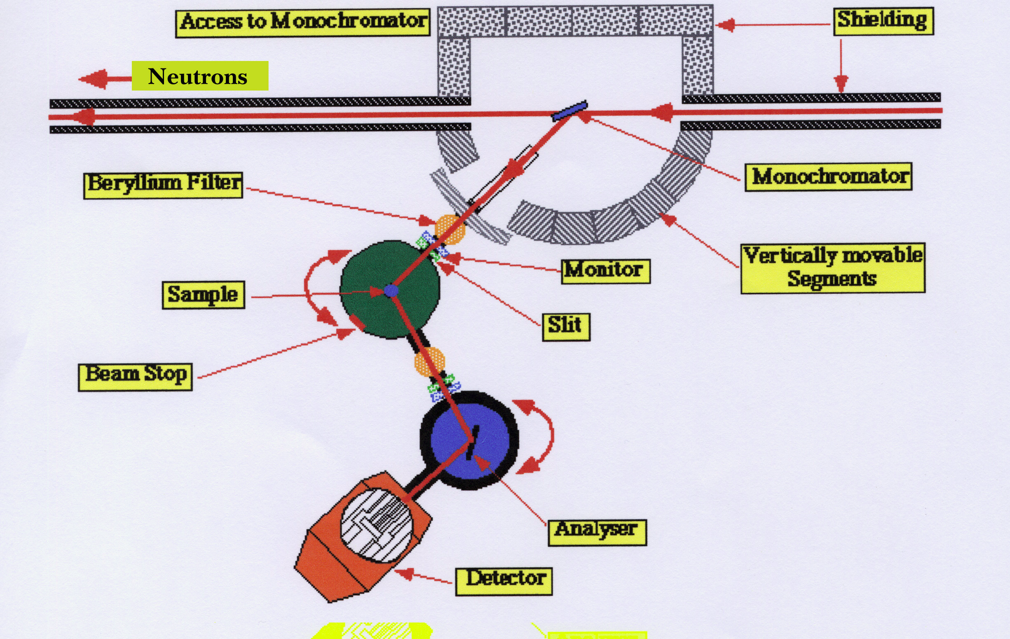
Triple-Axis Instrument
Image from: http://inac.cea.fr/Phocea/Vie_des_labos/Ast/ast_visu.php?id_ast=173

Slide 19
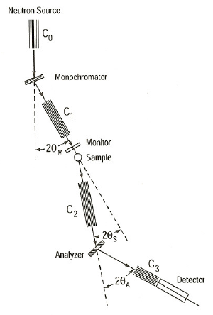
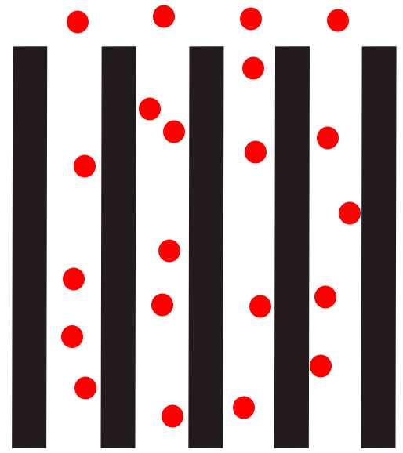
Triple-Axis Instrument

Slide 20

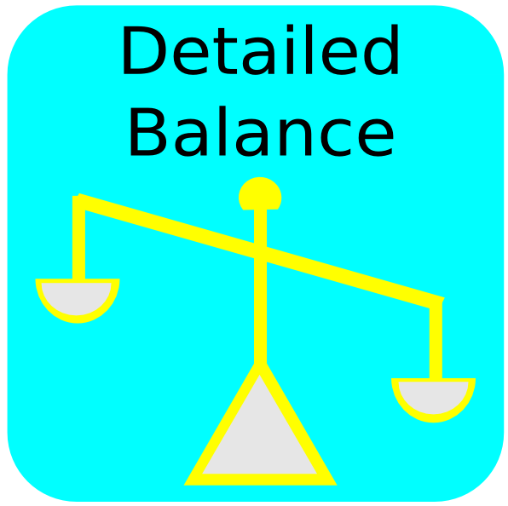
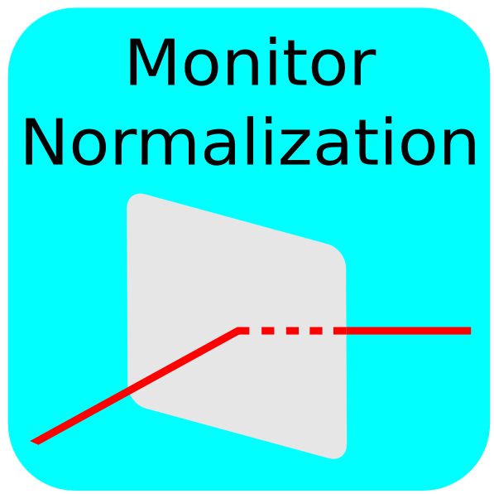
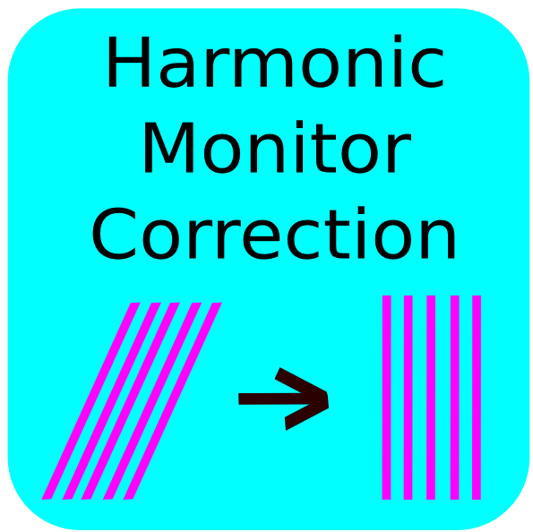
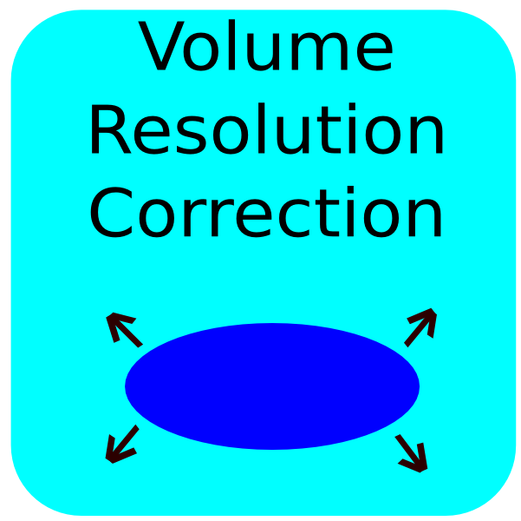

Triple-Axis Reductions
Join
Detailed Balance
Normalize Monitor
Harmonic Monitor Correction
Resolution Volume Correction
Error propagation throughout

Slide 21

Join
Combines two datafiles
Handle metadata appropriately
Remove duplicate points
Efficiency

Slide 22
Monitor Normalization
For scans with unequal monitor counts
Puts all detector counts
on the same monitor

Slide 23
Harmonic Monitor Correction
Constant-Q scans with fixed final Energy
According to Bragg's Law, higher harmonics of the beam may be included
  Over counted on monitor
Corrects detector counts

Slide 24
Detailed Balance
Neutrons alter sample energy and can create or destroy excitations
Population of excitations depends on temperature
Population affects intensity

Slide 26
Data reduction for
Offspecular Neutron Reflectometry
Brendan Rowan - SHIP
Notes:
Basic introduction – talk!

Slide 27
Caching intermediate results
Stores all calculated values and plots
Data serialization
Fingerprints (SHA-1 hash) include:
  Fingerprints of ancestors
  Module inputs
  Output terminal and node number
Notes:
Allows for optimization
Stores all calculated values along with plottable results
Data serialization: converting the data – references in memory – into string form
Plottable results: already a string (JSON object)
SHA1 cryptographic hash: fingerprint the current node in the reduction
Fingerprints of all parent nodes, arguments, output terminal itself, source code (need to update)
1/10^20 (sextillion, trillion billions)

Slide 28
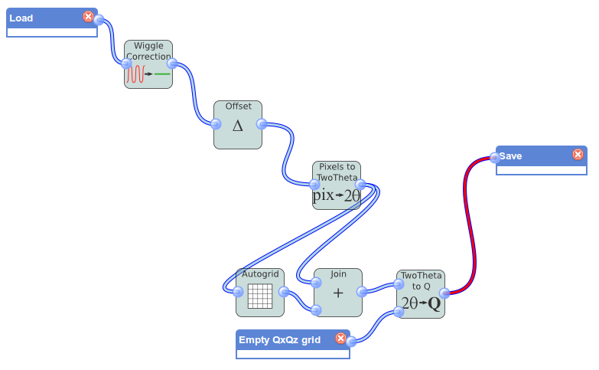
043ba1bd4c380659c25a9a06f2f0460061e9e3c4
af3139aa6ed38519e1492c1a370227148f7cfdcd

Slide 29
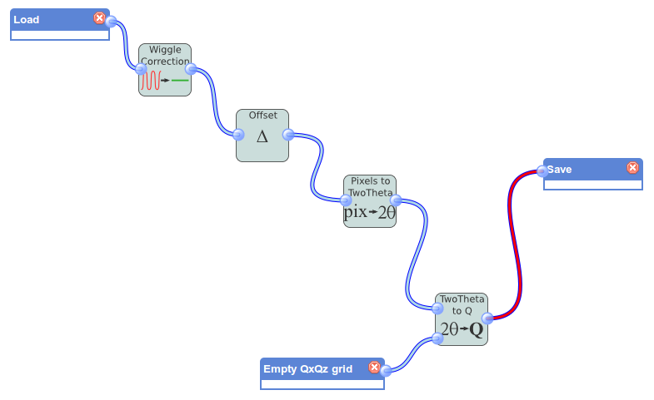
043ba1bd4c380659c25a9a06f2f0460061e9e3c4
af3139aa6ed38519e1492c1a370227148f7cfdcd

Slide 30
Offspecular reduction filters
General
  Wiggle correction
  Offset
  Pixels to 2θ
  Autogrid
  Combine
  θ, 2θ to Q-space
Polarized
  Insert timestamps
  Append polarization matrix
  Polarized combine
  Polarization correction
Notes:
Nonpolarized vs general
Apply polarization corrections then do reg. reduction

Slide 31


Wiggle correction
The sensitivity function of the detector needs to be corrected for and can be approximated with a sinusoid
Notes:
Corrects for sensitivity function of the detector

Slide 32
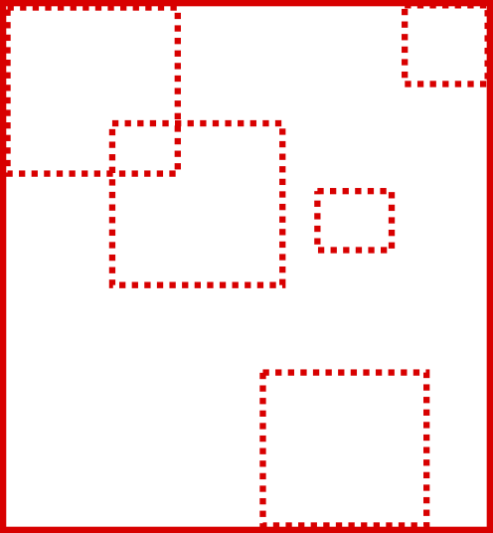

Autogrid/Combine
Autogrid creates an empty grid that covers the entire span of data
Implicit autogrid when combining
Notes:
Combine and autogrid are very related: combine uses autogrid to ensure that each data point is encompassed in the combined data (which will be in the plot)
Empty grid that covers the entire data
In a perfect world, the data should line up perfectly, but you usually have to layer

Slide 33
Polarization filters
Append polarization matrix – use He3 analyzer info to get time dependence of efficiency
Polarization correct – efficiency correction
Notes:
Insert timestamps – straight forward – shows how flexible our implementation is because we had to create this when end_times weren't provided.
Append polarization matrix – uses He3 Analyzer info to get efficiencies
Combine – along each polstate
Polarization correct – efficiency correction – analyzers and polarizers arent perfect, so it must be corrected for (99%/95% efficiency e.g.) with the known decay function for the analyzer, were fine

Slide 34
Future Plans - Offspecular
Slicing of data
  Box integrator
  Compare among spin states or samples
Custom filters
  Flexibility
Notes:
Various integrators, such as a box one. Use widgets? Interactors?
Analysis - Compare the integral between dif spin states and samples
Custom filters – people come to my mentor to ask for custom reductions, which they could probably program themselves with this. Flexibility!
Fittings – use simulations of models to test hypotheses

Slide 36
Future of Dataflow
Live updating of data
Plotting interactors
Data fitting library
Extend to more instruments
Support IE

Slide 37
Future of Dataflow
Live updating of data
Plotting interactors
Data fitting library
Extend to more instruments
Support IE – just kidding

Slide 38

Acknowledgements
William Ratcliff, Brian Maranville,
Paul Kienzle, Andrew Jackson
Julie Borchers
The SURF Directors

